Slide 1
CROP YIELD PREDICTION
USING DEEP LEARNING
16881A1210
16881A1217
16881A1228
16881A1251

Slide 2
INTRODUCTION:
Crop yield prediction and analysis is generally conducted by agricultural analysts who have profound insights about the working of this natural process. They use mathematical functions, data mining and statistical tools.
For our project, due to the unavailability of field data, we chose to use an agricultural simulation software APSIM(Agricultural Production Systems sIMulator ) to configure many parameters (soil, irrigation, fertilizer, plant density, etc) . The tool has many builtin simulations examples for variety of crops such as wheat, sorghum , cotton , maize, soyabean , etc;
We then use the various combinations of configurations from different generated simulations to create a Artificial Neural Network model to predict yield.
When given the exact parameters for each district, our model predicts which district is likely to give the higher yields for a particular crop.

Slide 3
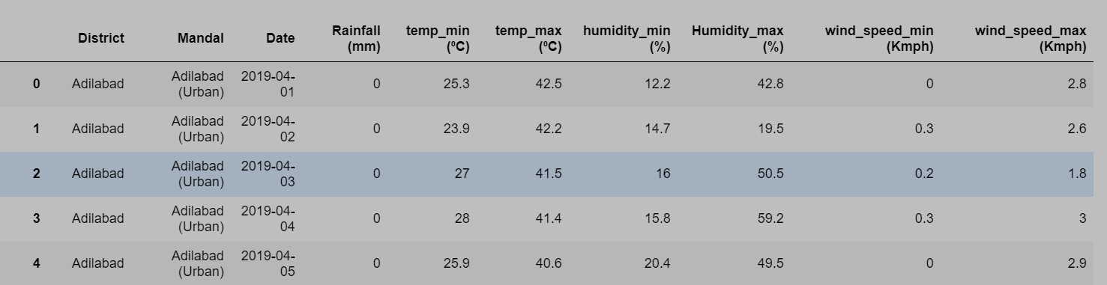
Preprocessing:
We obtained a weather dataset for the districts of Telangana from https://data.telangana.gov.in/ . Preprocessing refers to processing the data so that it is in the desired format and can be inputted to the system. Our goal was to preprocess it into meteorological (.met) file which is to be supplied to the APSIM software as one of the parameters.
We preprocessed the original data that looked like this:

Slide 4
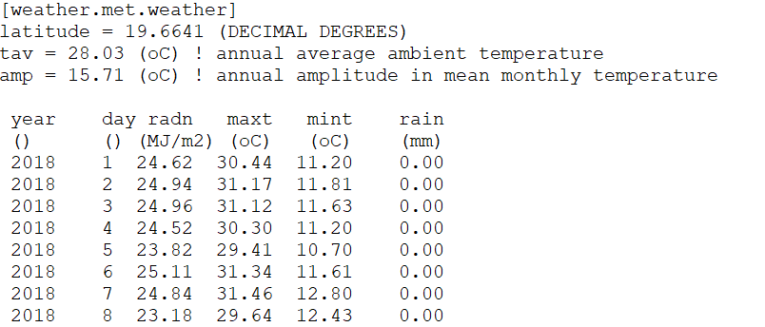
into meteorological (.met) files for 31 districts that look like this:
this is the format required for the APSIM input.
Following steps were involved in this preprocessing:
Grouping the data district and date wise.
Dealing with Null values and missing data.
Working on columns so that they match the format of (.met)
files

Slide 5
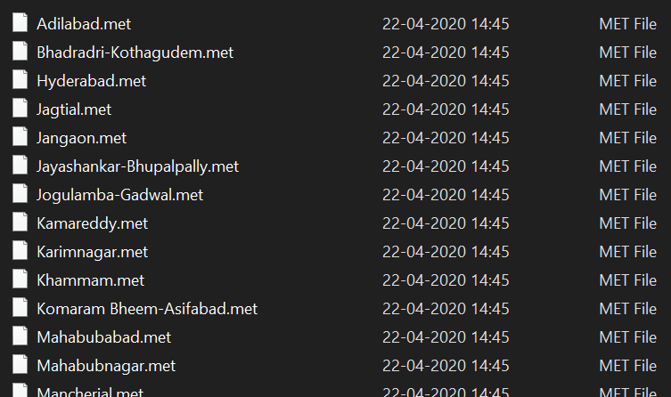
4) Building a regressor model for solar radiation using temperatures as inputs.
5) Determining the constants latitude , tav , amp as specified in the format above.
6) Writing the slices of the processed dataframe to (.met) files for 41 districts.
After this process , the generated (.met) files will look as follows:

Slide 6
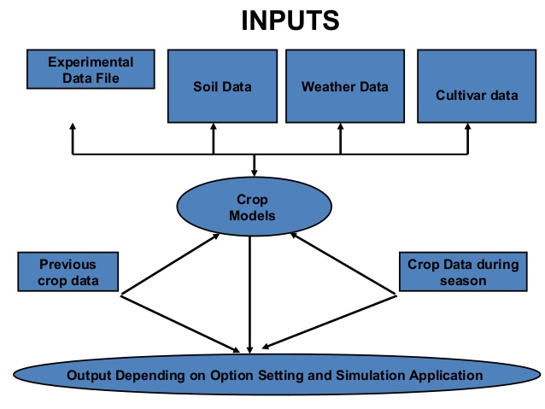
Generating and running APSIM simulations:
The key inputs and outputs of the APSIM simulations are:
Key input: Soil properties, daily climate data, cultivar characteristics, and agronomic management.
Key output : Crop yield (kg/Ha), Biomass (kg/Ha) and many other optional characteristics.

Slide 7
How we used APSIM:
After downloading and installing the setup and learning about how to use it, the first step is to load the already available cotton simulation in which we can change make changes to the parameters as required .
After loading the base simulation file , we browse the and select our meteorological (.met) file.
As shown in the snapshot on the next slide, there are a list of changeable parameters. From soil to fertilizer to sow date to plant density, we can set any of those values as desired .The tool has a huge set of changeable parameters that crop growth depends on. Even though these parameters are not all the factors plant growth completely depends on, but these are the best factors one can get hands on away from the agricultural field.
After setting the desired parameters, the final job is to run the simulation by clicking on the Run option in the toolbar. APSIM takes (.apsim) file as input and upon running the simulation, it produces one summary(.summ) and one output (.out) file for per simulation.

Slide 8
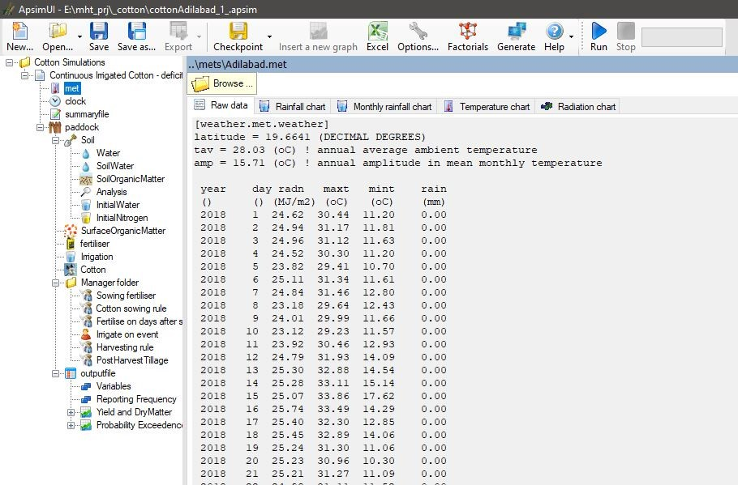

Slide 9
Automating the simulation process:
As we are working with 31 districts, we can’t go around modifying the simulation for each and every district with different configurations manually. So, we needed to somehow automate this like by using for loop over the districts and different configurations.
The (.apsim) file is in xml format. So we needed a XML parser that parses the simulation files and modifies its content. We chose the python built-in module XML.ElementTree to do the parsing. After parsing the file, we can update the contents by finding the attribute and setting its value.
Thus we generate multiple simulation files by looping over the 31 districts and different configurations of parameters.
Then we automate the process of running all the generated simulation files through command prompt
The generated files in the directory look as follows:

Slide 10
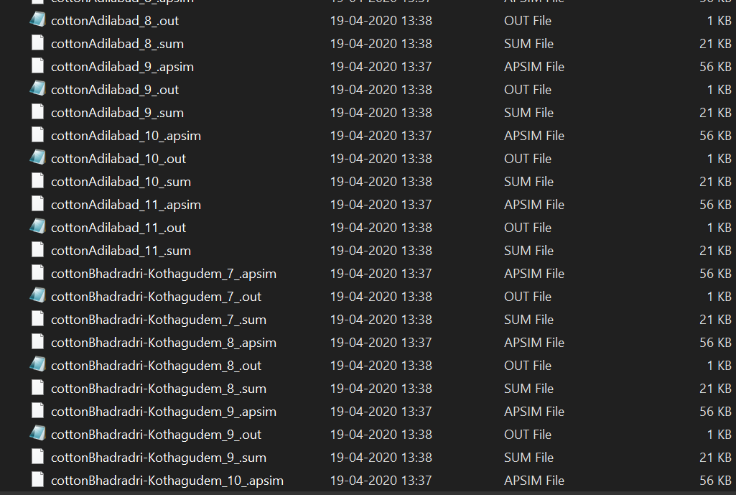

Slide 11
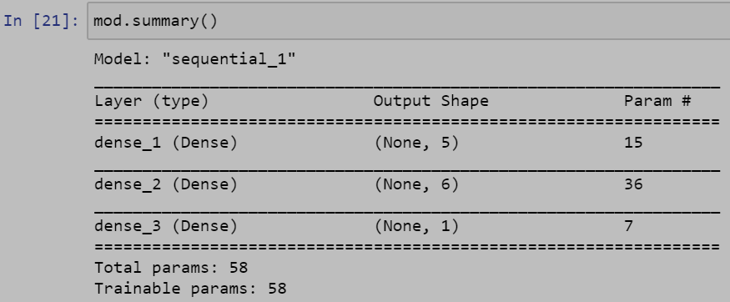
Building an ANN base model:
ANN model for regression:
Input: The input for our ANN is the parameters set in the APSIM (plant density, fertilizer etc), district , location of the district (Latitude and Longitude).
Output: The output is the yield in kilogram/hectare.
Summary of the base model:

Slide 12
Packages and functions used are
Numpy for arrays and simple mathematical operation on arrays
Pandas for reading csv files and creating dataframes and dataframe operations
train_test_split from sklearn to split the data into training and testing data points,
KerasRegressor from keras.wrappers.scikit_learn to perform grid search on hyperparameters. It wraps the NN as regressor so that grid search can be used.
GridSearchCV from sklearn to perform grid search
Keras for building ANN model
matplotlib and seaborn for plotting graphs
glob to access files and folders on local system
os to change the directory for file input/output

Slide 13
Hyperparameter tuning:
The best performance for any ANN is achieved when its hyperparameters are tuned correctly. We chose the following set of hyperparameters to be varied:
batch_size = [ 16 , 32 , 64 , 128 ]
epochs = [ 1, 10 , 50 , 100 ]
optimizer= [ 'rms' , ’adam’ , ’sgd’ ]
init_mode= [ 'normal' , 'uniform' ]
dropout_rate= [ 0.1, 0.2 , 0.3 , 0 ]
learn_rate= [ 0.001 , 0.01 , 0.1 , 1 ]
KerasRegressor enables us to wrap the NN as sickit learn regressor so that we can perform grid search using GridSearchCV .

Slide 14
The grid search gave the best fit as :
optimizer='adam' , init_mode='uniform' , dropout_rate=0.0 , learn_rate=0.001, epochs = 20, batch_size = 32
Testing results:
We achieved an mean_absolute_error of 0.05 on test data and comparison of actual test output and predicted output can be visualized through the plot below

Slide 15
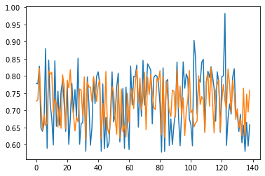
The blue lines represent actual values and orange ones represent the model predicted values. As we can see the model fits the data pretty well except for few outliers.
Also we have chosen only a handful of parameters to vary , thus our dataset is small and there are chances of overfitting.

Slide 16
CONCLUSION:
We conclude that we have modelled crop yield prediction to some extent because we had chosen only a handful of parameters to vary. Our metric score was pretty decent and given the cotton crop our, model can predict which district might produce higher yields per given area for given set of parameters.
The project made us realize how complex is the natural process of crop growth. We had no prior knowledge in the agriculture sector and had to spend much time on finding the suitable values for the dependent parameters. Initially , unavailability of field data was a huge setback and this project wouldn’t have been possible if we didn’t come across APSIM tool.

Slide 17
FUTURE WORK:
We desire to do further research in the agriculture sector and crop growth, so that we can work with more values and configurations of other dependent factors. Incorporating more of the factors that yield depends on requires deep study of crop growth and field work knowledge, but it is doable.
One of the ideas for future work we have is to incorporate image data (photographs of crops taken at regular time intervals throughout the different stages of crop growth) and add Convolutional Neural Networks to the project for image data. This will require farmers to be equipped with imaging tools and camera equipment.
When our project is applied at individual field level instead of district level which we have done for now, we can provide accurate parameters and also create more and more simulations and train deeper networks which will be able to better model the natural process.

Slide 18
THANK YOU

